Slide 1

In-Game Assessment Scoring Engine -A predictive model that scores in-game assessment which leads to better-designed games and improved learning outcome
Presented By
Jagannathan Govindan
Jason Min-Liang Kang
Ram Krishnan
Steve DeVito

Slide 2
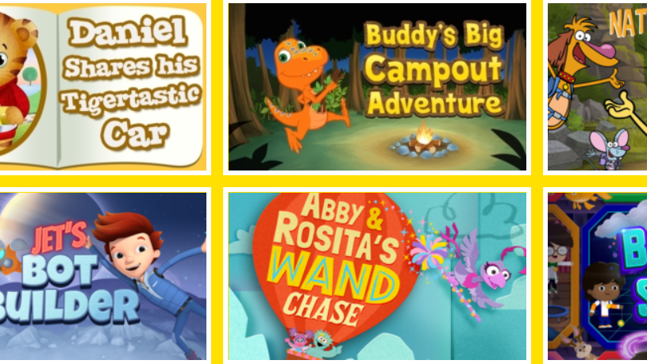
PBS KIDS
PBS Kids is the brand for most of the children's programming aired by the Public Broadcasting Service (PBS) in the United States.
PBS produces curriculum-based entertainment for children. PBS KIDS leverages the full spectrum of media and technology to build knowledge, critical thinking, imagination and curiosity. By involving parents, teachers, caregivers and communities as learning partners, PBS KIDS helps to empower children for success in school and in life.

Slide 3

About the Dataset
The data is collected by an app called PBS KIDS Measure Up. It is an app that helps children ages from 3 to 5 to learn early math concepts while navigating through a map and completing levels/assessments. The data records the number of attempts a child will take to pass a given assessment
In the dataset, an assessment is a combination of multiple rows, and each row corresponds to an in-game event. A group of events that constitute an assessment have the same event_id. In the training dataset, the complete events of an assessment are given. In the testing dataset, events are truncated after the start event of an assessment. The challenge is to predict the events after the start event in testing dataset.

Slide 4
Sample Dataset
event_id | game_session | timestamp | event_data | installation_id | event_count | event_code | game_time | title | type | world
0 | 27253bdc | 45bb1e1b6b50c07b | 2019-09-06T17:53:46.937Z | {"event_code": 2000, "event_count": 1} | 0001e90f | 1 | 2000 | 0 | Welcome to Lost Lagoon! | Clip | NONE
1 | 27253bdc | 17eeb7f223665f53 | 2019-09-06T17:54:17.519Z | {"event_code": 2000, "event_count": 1} | 0001e90f | 1 | 2000 | 0 | Magma Peak - Level 1 | Clip | MAGMAPEAK
2 | 77261ab5 | 0848ef14a8dc6892 | 2019-09-06T17:54:56.302Z | {"version":"1.0","event_count":1,"game_time":0... | 0001e90f | 1 | 2000 | 0 | Sandcastle Builder (Activity) | Activity | MAGMAPEAK
3 | b2dba42b | 0848ef14a8dc6892 | 2019-09-06T17:54:56.387Z | {"description":"Let's build a sandcastle! Firs... | 0001e90f | 2 | 3010 | 53 | Sandcastle Builder (Activity) | Activity | MAGMAPEAK
4 | 1bb5fbdb | 0848ef14a8dc6892 | 2019-09-06T17:55:03.253Z | {"description":"Let's build a sandcastle! Firs... | 0001e90f | 3 | 3110 | 6972 | Sandcastle Builder (Activity) | Activity | MAGMAPEAK
Table 1.1 Input Features
game_session | installation_id | title | num_correct | num_incorrect | accuracy | accuracy_group
0 | 6bdf9623adc94d89 | 0006a69f | Mushroom Sorter (Assessment) | 1 | 0 | 1.0 | 3
1 | 77b8ee947eb84b4e | 0006a69f | Bird Measurer (Assessment) | 0 | 11 | 0.0 | 0
2 | 901acc108f55a5a1 | 0006a69f | Mushroom Sorter (Assessment) | 1 | 0 | 1.0 | 3
3 | 9501794defd84e4d | 0006a69f | Mushroom Sorter (Assessment) | 1 | 1 | 0.5 | 2
4 | a9ef3ecb3d1acc6a | 0006a69f | Bird Measurer (Assessment) | 1 | 0 | 1.0 | 3
Table 1.2 Labels

Slide 5
Problem Statement/Business Description
This problem comes from Kaggle 2019 Data Science Bowl competition. It is the result of a collaboration between Kaggle (online data scientist community) and PBS KIDS (children programming aired by PBS). The goal is to gain insights into how gaming can help children learn important skills for success in school and life. The idea is to create a machine learning model that will predict scores on in-game assessments that will lead to better-designed games and improved learning outcomes. The model will aid in discovering important relationships between engagement with high-quality educational media and learning processes.

Slide 6
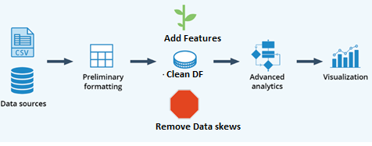
Data Munging and Exploratory Analysis

Slide 7
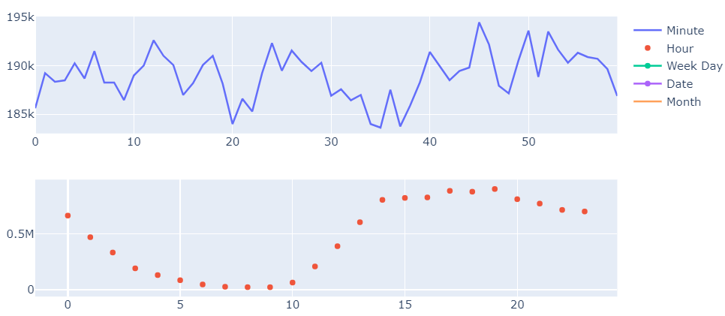
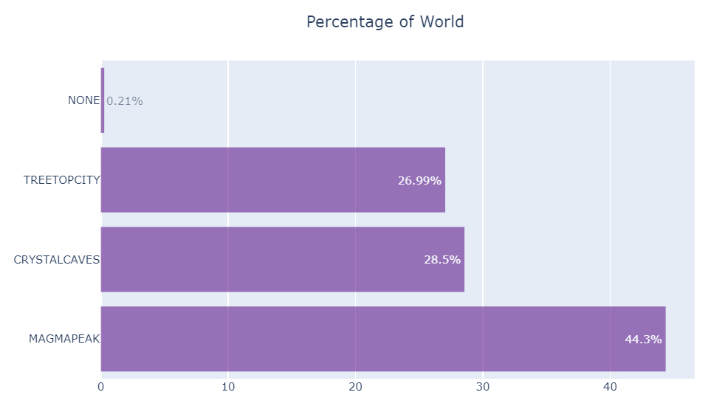
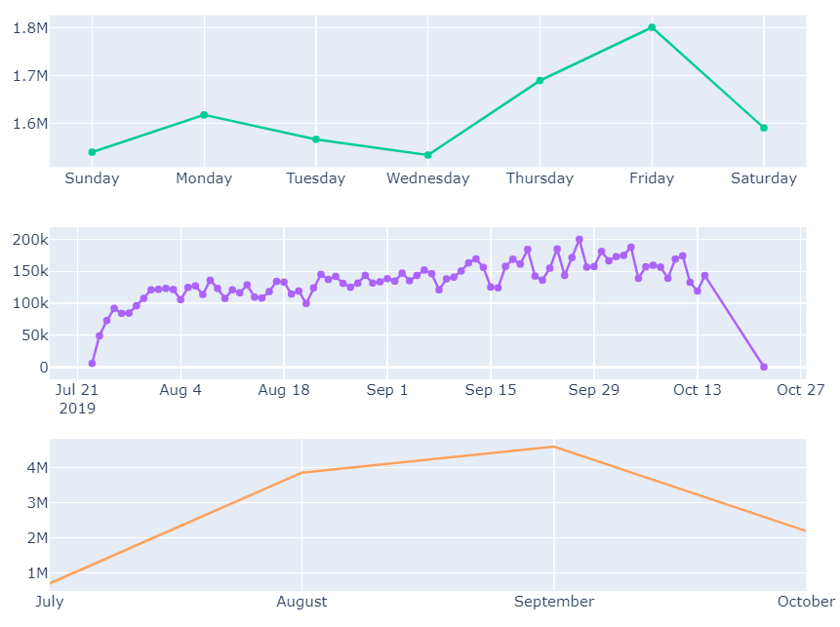
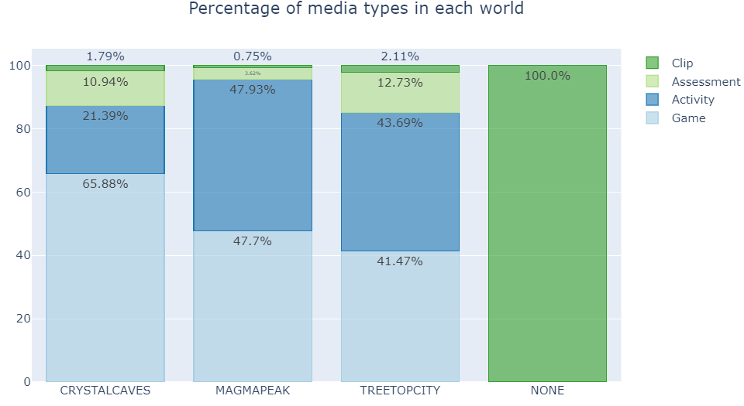
EDA Continues

Slide 8
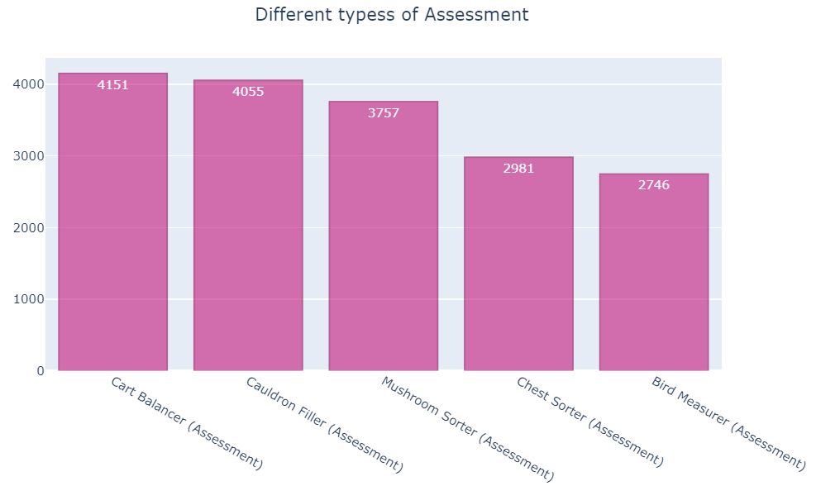
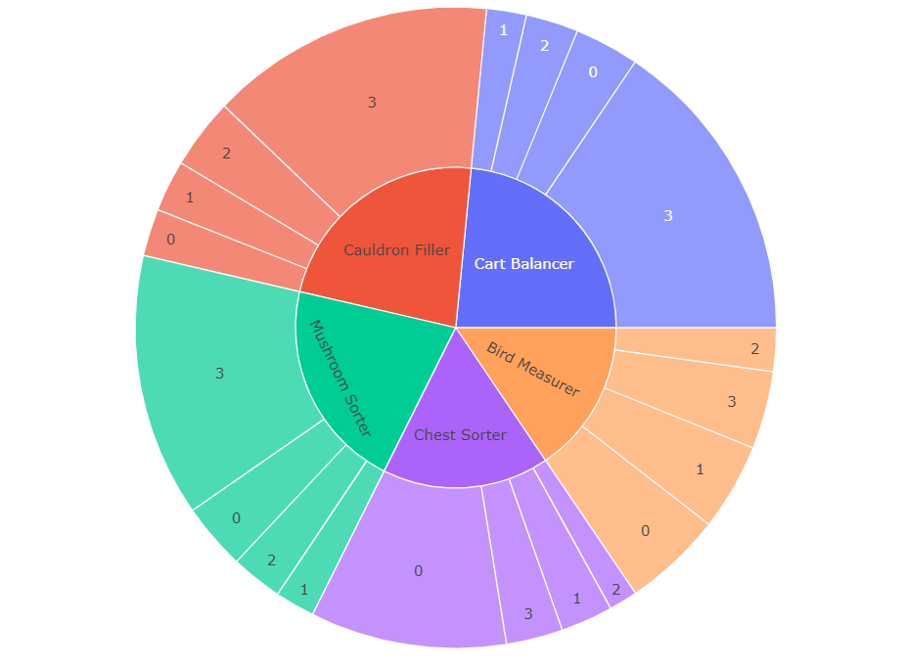
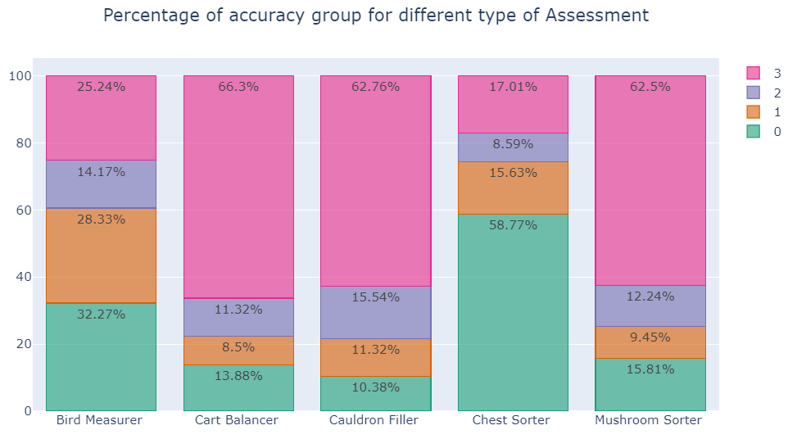
EDA continues
Sun burst for Assessment to accuracy group

Slide 9
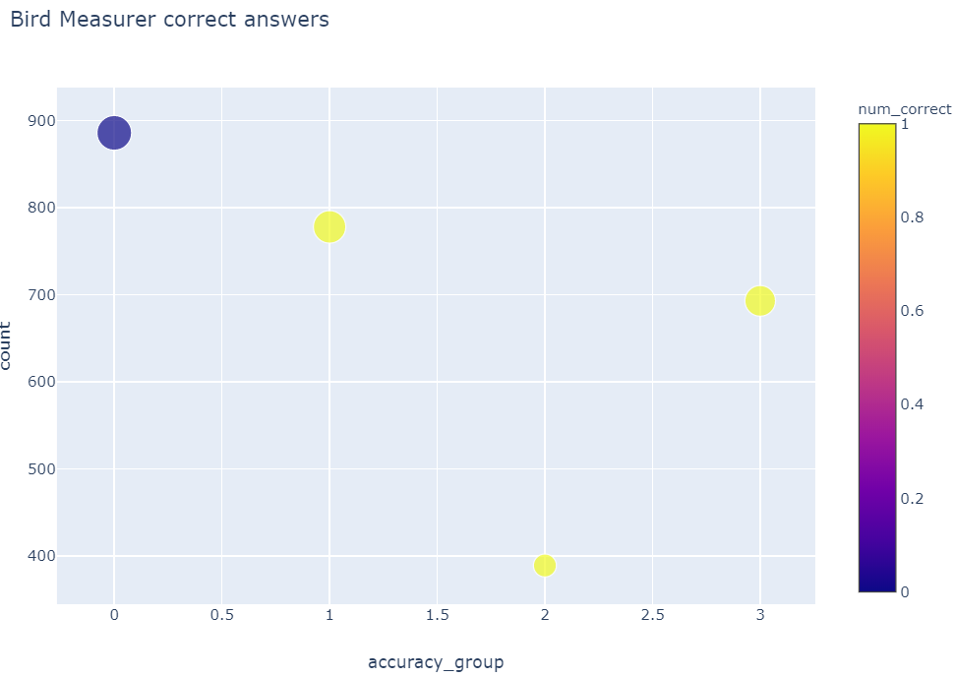
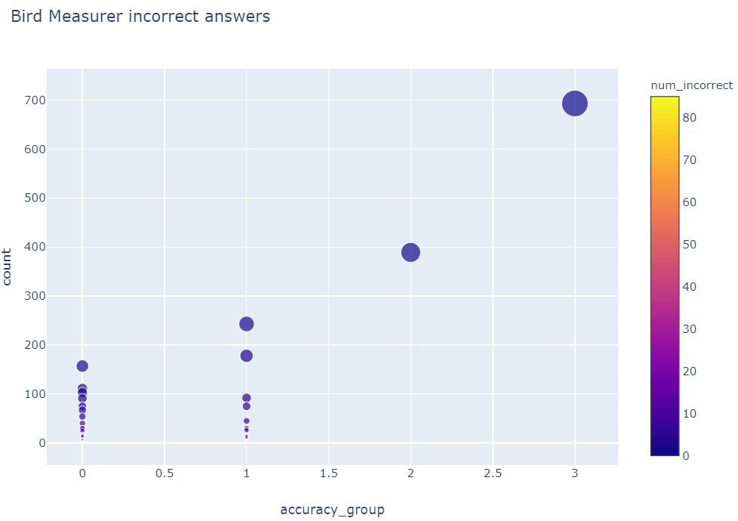
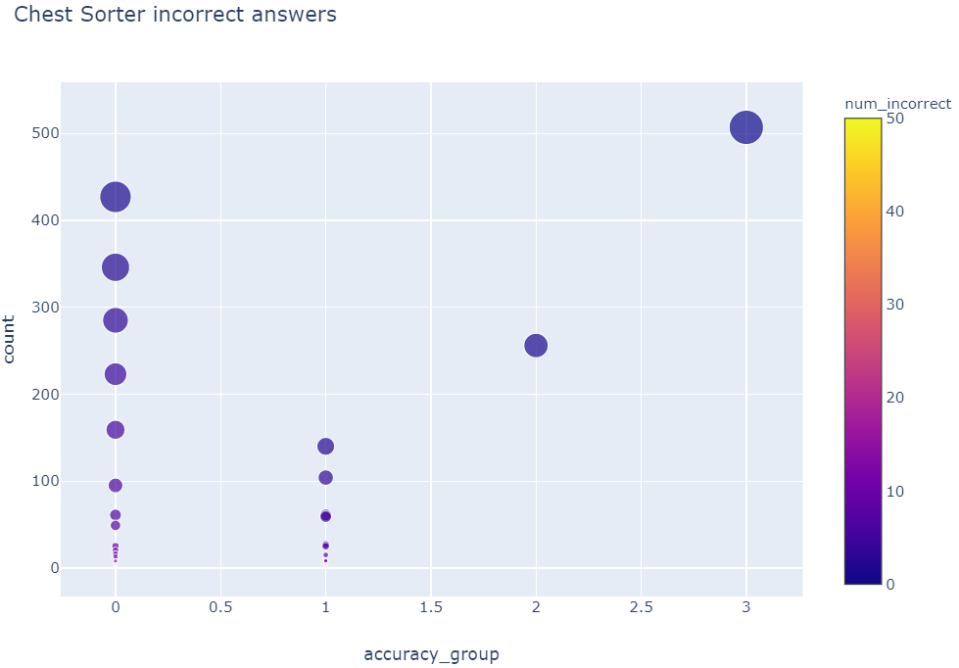
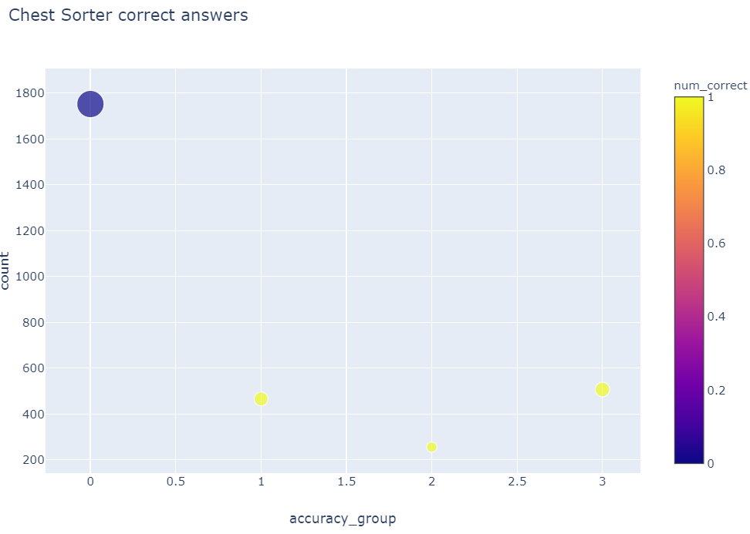
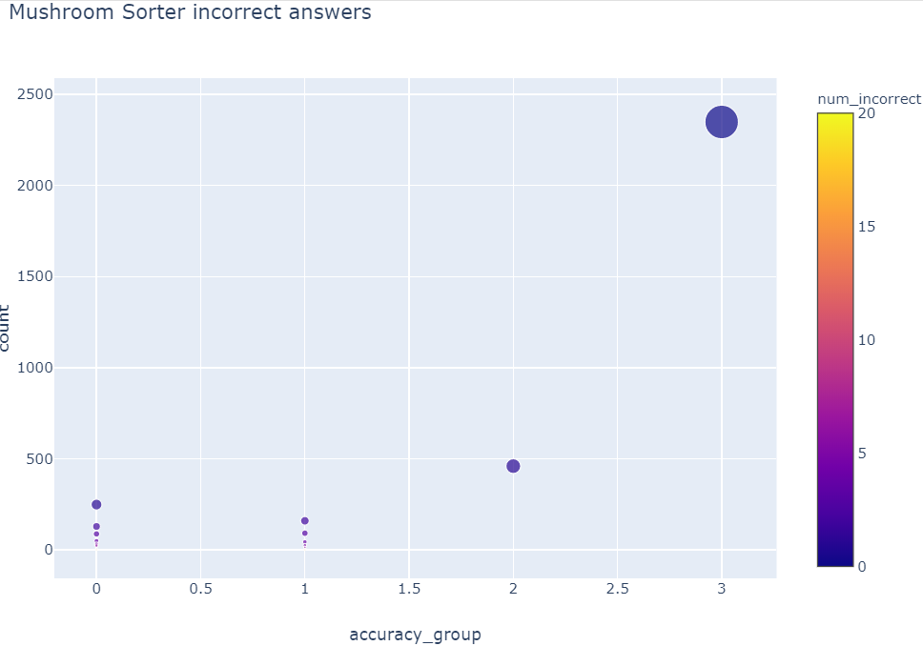
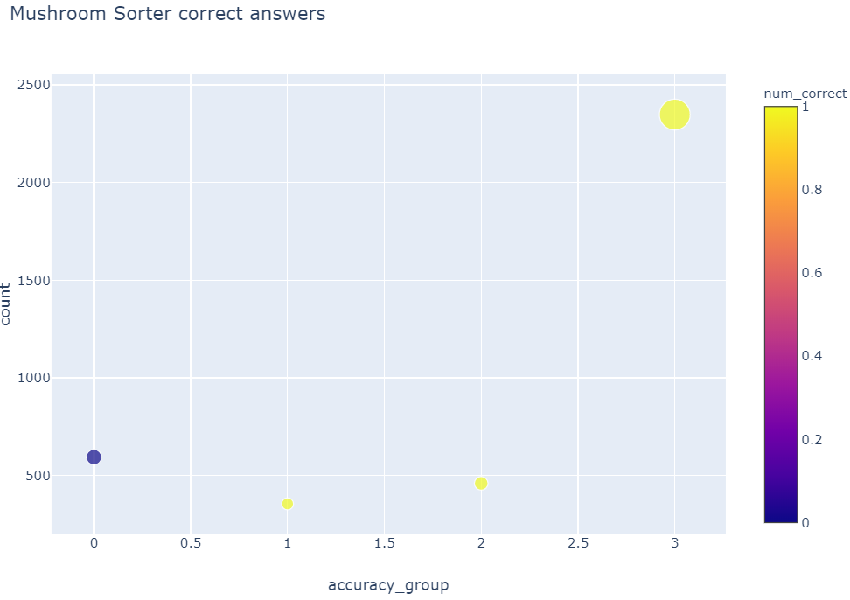
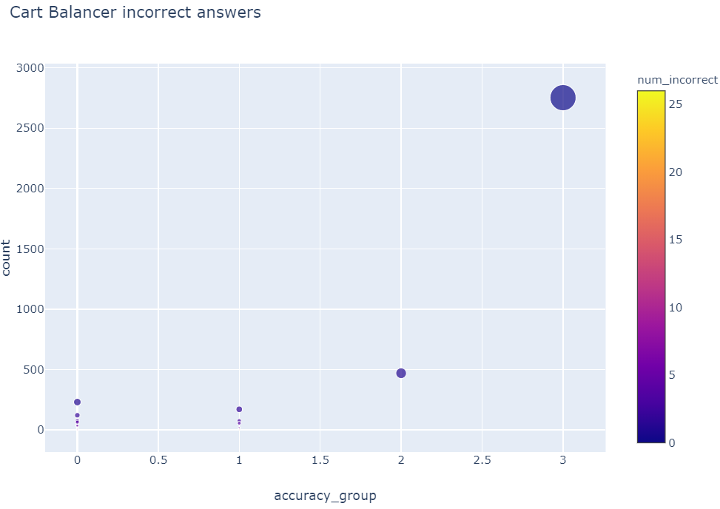
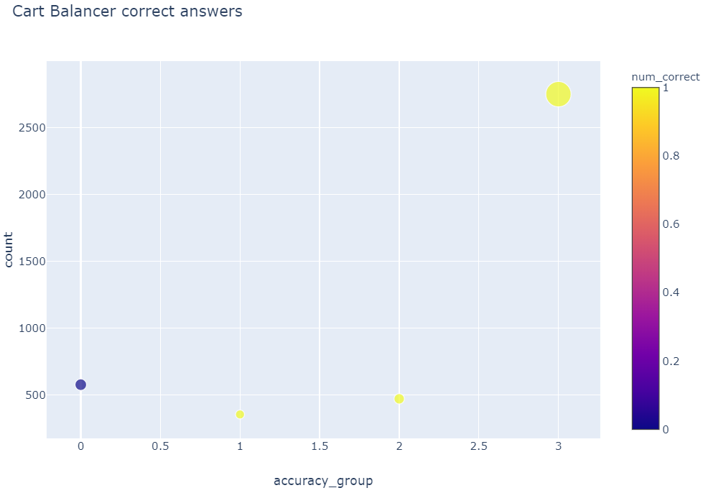

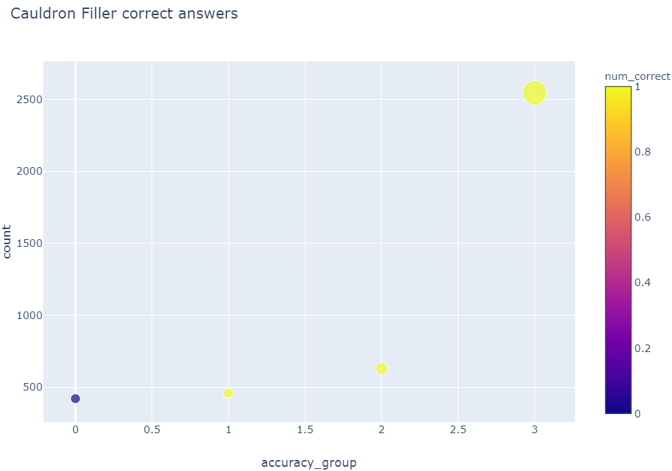
Accuracy Group Vs Correct/Incorrect Answers for Different Assessment Types

Slide 10
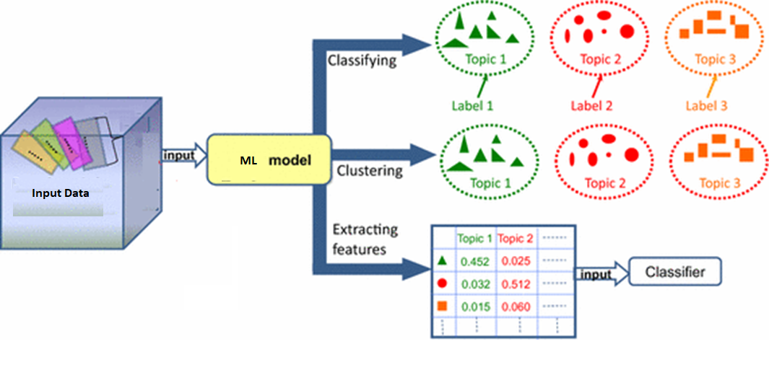
Modeling

Slide 11
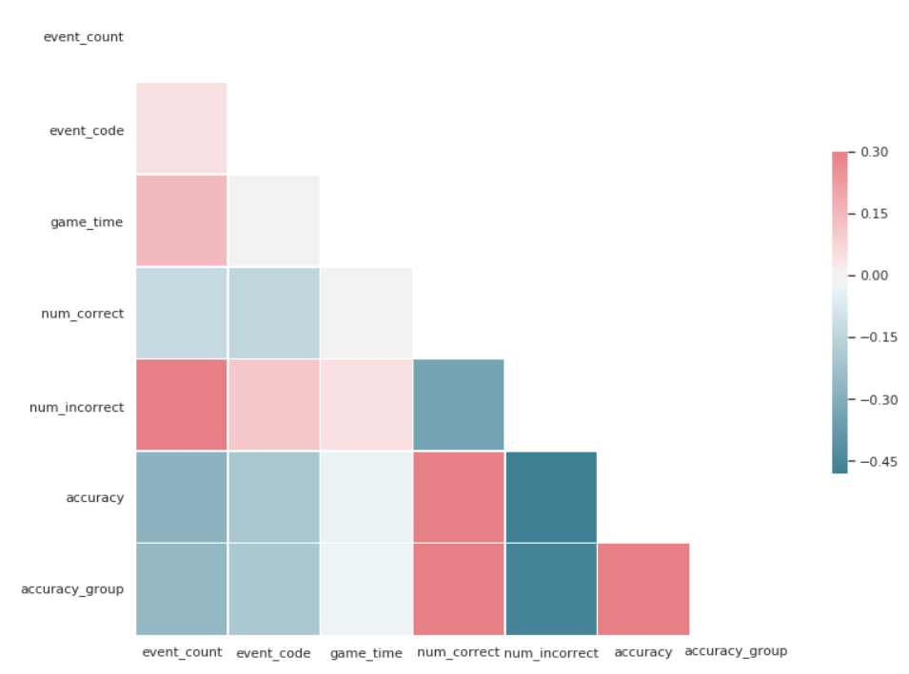
Correlation Matrix

Slide 12
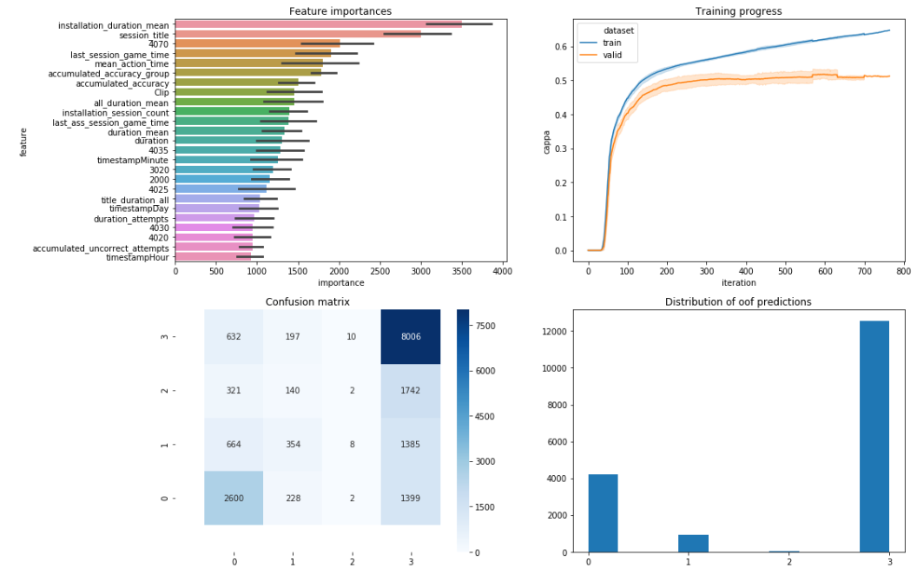
Model Outcomes

Slide 13
Results

Slide 14
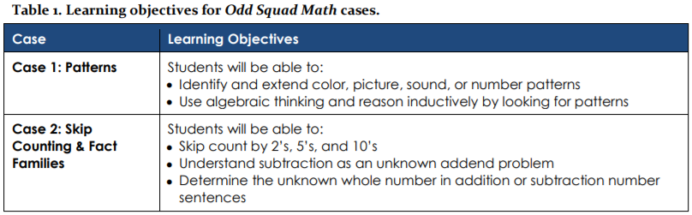
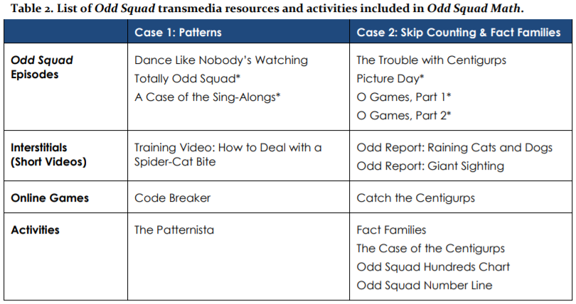
Conclusion
PBS KIDS designed and developed the odd squad television series and transmedia suite, which included educational media, television episodes, online games and hands on resources
Table 1 and 2 shown here shows the learning objective and activities of this program

Slide 15
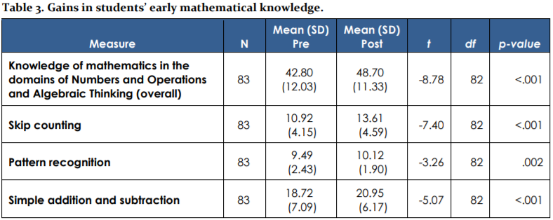
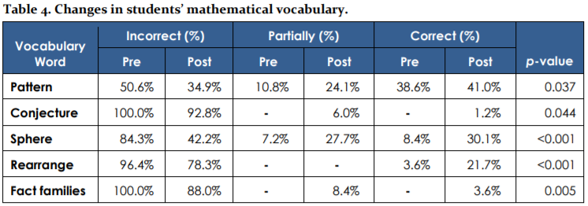
Study Findings
A study conducted by WestEd on Odd Squad (Learning Math with PBS KIDS Games and App) showed improvement in skills acquired by kids
Table 3 and 4 shown here compares the metrics accessed from KIDS pre and post Odd Squad programme

